Slide 1
Everything DiSC Workplace®

Slide 2
How You See Yourself
Fast-Paced & Outspoken
Cautious & Reflective

Slide 3
How You See Yourself
Questioning & Skeptical
Accepting & Warm

Slide 4
How You See Yourself
Fast-Paced & Outspoken
Questioning & Skeptical
Accepting & Warm
Cautious & Reflective

Slide 5
Group Discussion
Why did you answer the way that you did?
Give examples
Record responses on your flip chart

Slide 6
Goals
Learn about DiSC® and the Everything DiSC Workplace® Map
Identify your style and explore the priorities that drive you
Discover similarities and differences among the DiSC styles

Slide 7
Discovering DiSC®
D
Fast-Paced & Outspoken
i
Questioning & Skeptical
Accepting & Warm
C
S
Cautious & Reflective

Slide 8
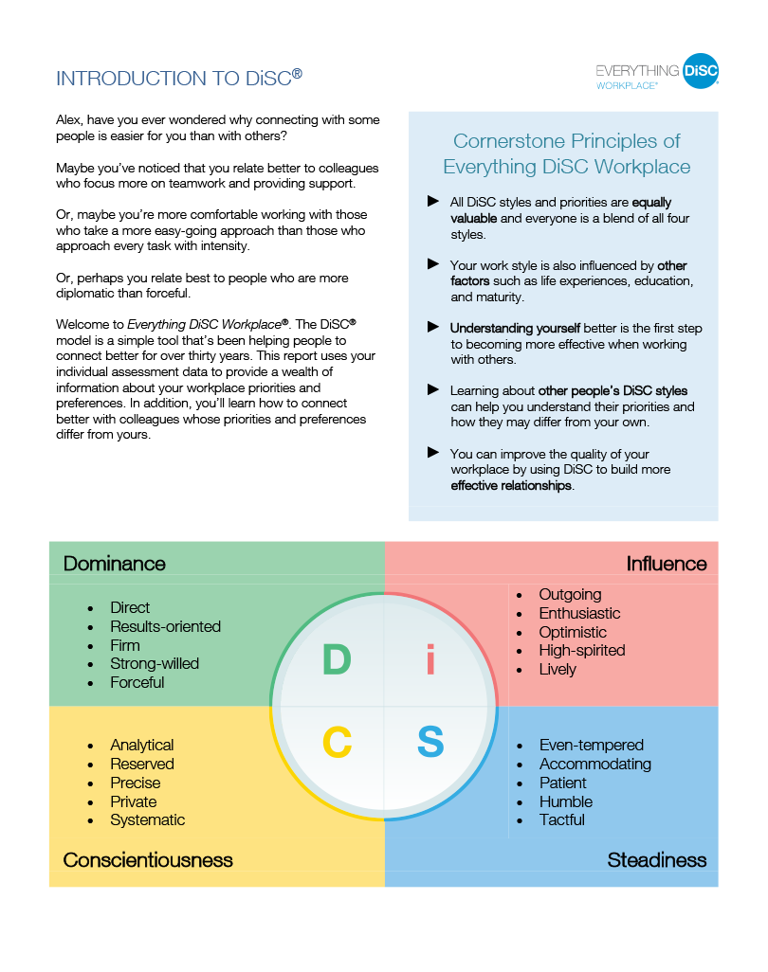
Cornerstone Principles
Everything DiSC Workplace® Profile Page 2

Slide 9
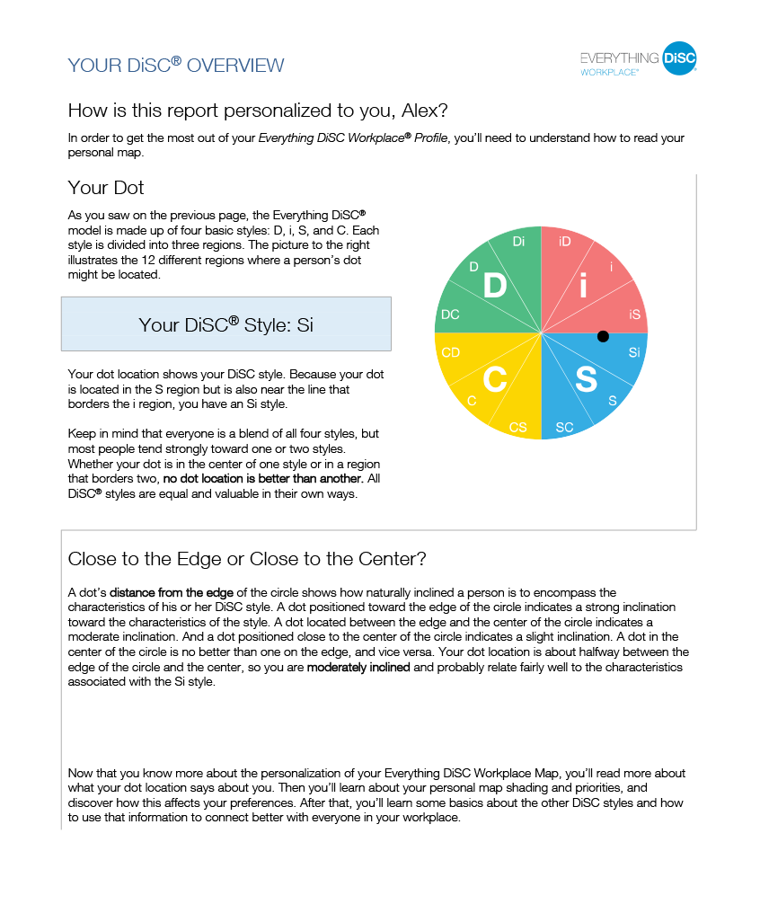
Your DiSC® Style
Page 3

Slide 10
Image Credits
Elena_Elisseeva/Shutterstock, Steve_Cukrov/Shutterstock, michaeljung/Shutterstock, Iko/Shutterstock, spaxiax/Shutterstock, Asier_Romero/Shutterstock, kurhan/Shutterstock, Dean_Drobot/Shutterstock, Technomatic/Shutterstock, szefei/Shutterstock, fotogenicstudio/Shutterstock, ASDF_MEDIA/Shutterstock, Ebtikar/Shutterstock, Djomas/Shutterstock, Panic_Attack/Shutterstock, Syda_Productions/Shutterstock, Rawpixel.com/Shutterstock, Uber_Images/Shutterstock, milanzeremski/Shutterstock, Song_Pin/Shutterstock, SFIO_CRACHO/Shutterstock, Iakov_Filimonov/Shutterstock, Linderina/Shutterstock, Matej_Kastelic/Shutterstock, GaudiLab/Shutterstock, Monkey_Business_Images/Shutterstock, Juices_Images_Ltd, /Shutterstock.UfaBizPhoto/Shutterstock, wavebreakmedia/Shutterstock

